Slide 1
HEART & SOUL OF MACROBIOTICS
With
Julie S. Ong
1
Notes:
The Macrobiotic Approach to Migraines
Good morning. Thank you for coming. Welcome to the presentation titled “Heart & Soul of Macrobiotics.”

Slide 2

Would you like to have better health and increased energy?
2
Notes:
Good evening everyone!
Scan the Audience
How many people here would like to have better health and increased energy? Raise my right hand

Slide 3
Would you like to eat to live instead of living to eat?
3
Notes:
How many people here would like to eat to live instead of living to eat Raise my left hand. Can anybody relate to that, eating to feel better on all levels of being versus eating for immediate gratification?
Great!

Slide 4





Give yourself permission
Go crazy!!!
Indulge fantasies!
Be creative
ALL-ABOUT-ME
Give yourself gifts
4
Notes:
My name is Julie Ong, and I am author and macrobiotics expert of the upcoming book, The Everything Guide to Macrobiotics, which will be released in July. Welcome to our talk. I want to congratulate all of you who have taken the time to give yourselves the gift to come here to learn how to improve your health to live the life you really want… one that is fulfilling, joyful and meaningful!
For the next few minutes I want you to forget about everyone else → job, home, all of it.
Except, YOU
For awhile I want you to be ALL-ABOUT-ME.
Indulge fantasies
Give yourself gifts
Be creative
Go crazy!

Slide 5









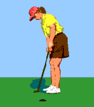

Imagine . . .
- Health -
Well-being
5
Notes:
I will be opening up a treasure chest that can help you create more health and well-being in your life. It is my intention to help you connect with nature and live a macrobiotic life through mindful food choices. Trusting your intuition will cultivate your connection with your spirit. You will be guided toward a life filled with happiness, freedom, and peace. As your heart opens in a deep and enduring way, this feeling of balance and harmony becomes normal, something you will strive to attain.

Slide 6

New Level
purpose of talk
To learn about the purpose of the body
To learn about intuition
To learn about spirituality
To learn how to move from “dis-ease” to new awareness of our higher path
6
Notes:
I want to take this to another level today. / To abandon the one size fits all formulas
How are we going to reach that new level?
We are going to proceed with our dialog today toward the following: To learn about the purpose of the body, to learn about intuition, to learn about spirituality, and to learn how to move from dis-ease to a new awareness of our higher path.

Slide 7



Set the Foundation
Gardening
Till the soil / remove the stones & weeds
Add rich fertile soil
Identify and plant new seeds
Bear whole fruit
7
Notes:
First, we’ll set the foundation and do some gardening. We’ll till the soil, remove the stones and weeds which represent the old ways of thinking. We will add rich fertile soil in which to plant new ideas.
We will identify and select our own seeds. You’ll plant them as you absorb the new concepts.
Then, it will eventually bear whatever fruit your plant should bear, which will be your new-found health and well-being.

Slide 8
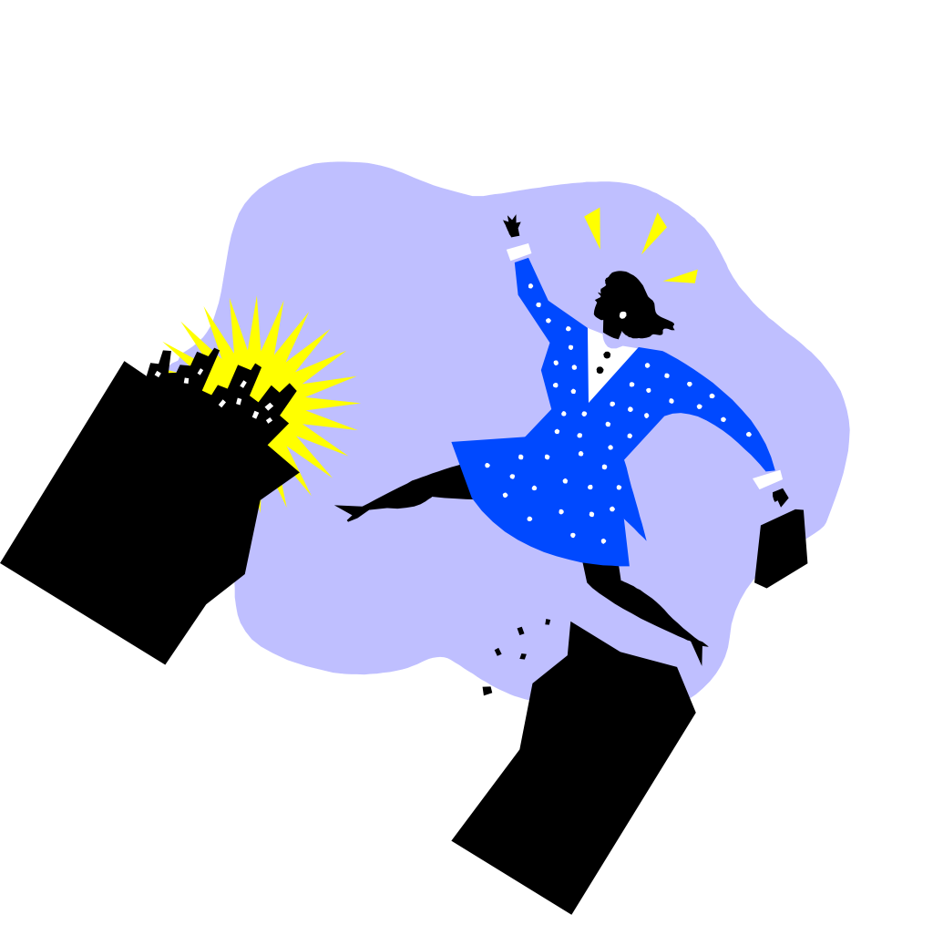
MACROBIOTICS
8

Slide 9

Macrobiotics is about Balance
9
Notes:
What is Balance?

Slide 10

What is Balance?
Webster’s Dictionary definition:
An aesthetically pleasing integration of elements
Harmony
Mental and emotional steadiness
Physical equilibrium
10
Notes:
This is Webster’s Dictionary definition.

Slide 11
Macrobiotics
Macro = large
Bio = life
Ancient practice
Harmony with order of universe
Views person as whole
  Physical
  Mental
  Spiritual
Which organs have problems
Heals person holistically
Whole foods
11
Notes:
If we look at the word macrobiotics, we see that “macro” means large and “bio” means life. Macrobiotics is the ancient practice of living in harmony with the order of the universe. The macrobiotic approach to migraines is to view the person as a whole, determine which organs have problems and heal the person holistically with whole foods.

Slide 12
Macrobiotic Practice
Living in accord with nature
  “Large life”
Taking responsibility for your own health from a holistic viewpoint
Focusing on healing yourself on many different levels
Discovering which areas are affected by dis-ease
12
Notes:
When we practice macrobiotics, we are living in accord with nature, which is the definition “large life.” The macrobiotic person takes responsibility for his or her own health in a holistic view and focuses on healing himself on many levels rather than just the physical body.

Slide 13
Western vs. Macrobiotic Approach
Western Approach
High technology
Cure
Partial effects
Material components
Nutritional information
Macrobiotic Approach
We are part of nature
Heal the cause
Energetic comprehensive effects
Deepest level changes
Body is made out of food
13
Notes:
We are a part of nature, but we created medicine which uses high technology to fix the problem. While the medical approach is the find a cure for the problem by treating symptoms, the macrobiotic approach is to heal the cause behind the symptoms. Modern nutrition looks only at the partial effects of food, which are the material components that provide information. However, macrobiotic nutrition looks at the energetic, comprehensive effect of food from the point of view of balance. More than that, the deepest level of person starts to change, since the body is made of food.

Slide 14
Our bodies are designed to take in nutrition and eliminate toxins.
14
Notes:
The body has a function to take in nutrition and eliminate toxins.

Slide 15
Healing ⬄ Balance
Macrobiotics looks at balance
  How everything fits together as a whole
Problems occur when we are not eating according to body’s design
  Messages
    Pain
    Disease
  Blockage or stagnation
  Out of balance with nature
15
Notes:
Macrobiotics looks at healing from point of view of balance--how everything fits together to effect you as a whole. Problems occur when we are not eating according to body design. The body sends us messages in the form of pain, such as migraines, that tell us where there is blockage (stagnation) in the body, which is a sign that we are out of balance with nature.

Slide 16
Energy System
Asian concept of human body
Energy system
Organs communicate with each other
  Nourish
  Control
Chi = life force
Meridians = channels for energy
Energy blocked
  Congestion
  Stagnated energy
16
Notes:
In the Asian concept of the human body, they have the digestive system, circulatory system, respiratory system, endocrine system, etc. They also have the energy system, in which the life force or chi flows that allows the organs to communicate with each other to nourish or control the activity of other organs. This energy can become blocked through congestion, which can cause problems in other systems, because the systems are connected through the meridians (energy channels).

Slide 17

  Energy Awareness Game
17
Notes:
Energy Awareness Game

Slide 18
Whole Foods
Contain all essential nutrients in balanced proportions
Harmonize with body’s needs
  Compared to processed, refined foods and supplements
Seasonal, locally grown foods
  Centering energetically
  Adapt to climate and environment
Extreme foods weaken organs
  Susceptible to disease
18
Notes:
Processed and refined foods and supplements, although derived from whole foods, do not retain the same energy as whole foods that contain all the essential nutrients in balanced proportions that harmonize with the body’s needs. Furthermore, eating seasonal, locally grown food allows the body to become more centered energetically by adapting to the climate and environment. Eating extreme foods that are inappropriate for the climate and region often leads to weakness in the organs, so that the body becomes more susceptible to disease.

Slide 19
Extreme Foods
Meat
White flour
Caffeine
Sugar and alcohol
  Destroys beneficial bacteria
  Depletes body of B vitamins
Dairy
  Causes mucous congestion
  Digestive problems
19
Notes:
Examples of extreme foods that weaken the body and cause stagnation are over consumption of meat, white flour, caffeine, alcohol, and dairy products.

Slide 20
What are basics of a meal?
Whole Grain
Vegetable
20
Notes:
What is a macrobiotic meal? Whole grain and vegetable is the image of a meal.

Slide 21

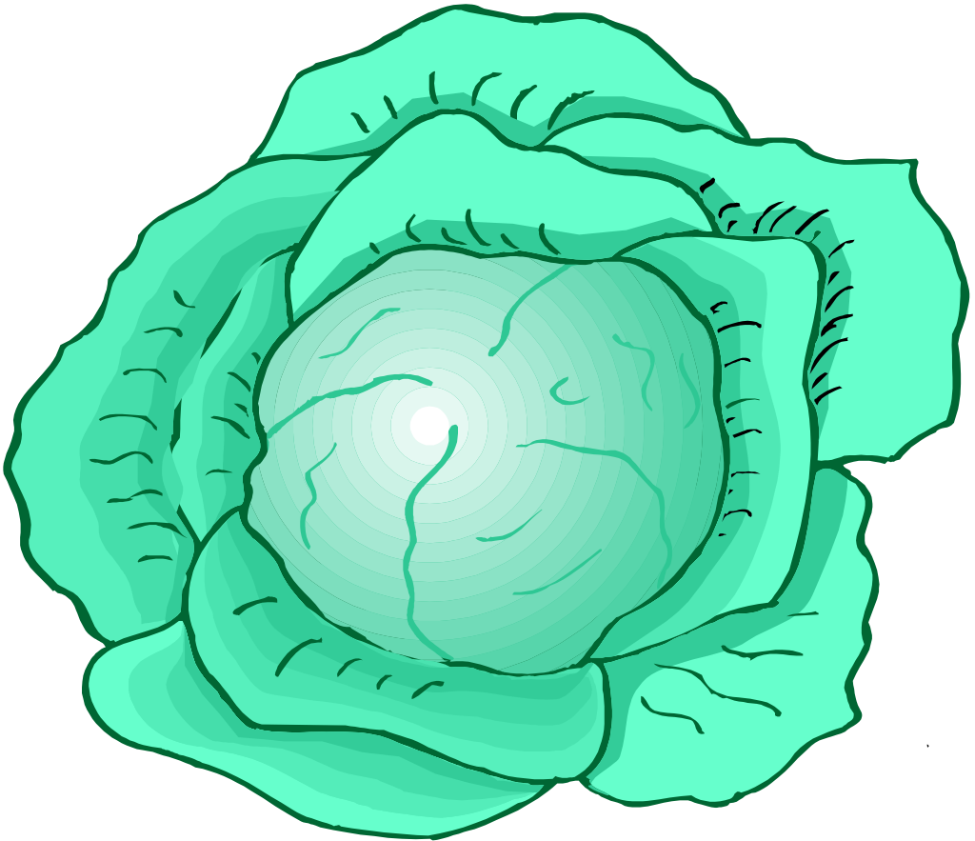
Image of Meal
Grain
  Primary food
  Gives us direction in life
Vegetables
  Secondary food brings meal to completion
  Help us express how we live our life (creative expression)
21

Slide 22
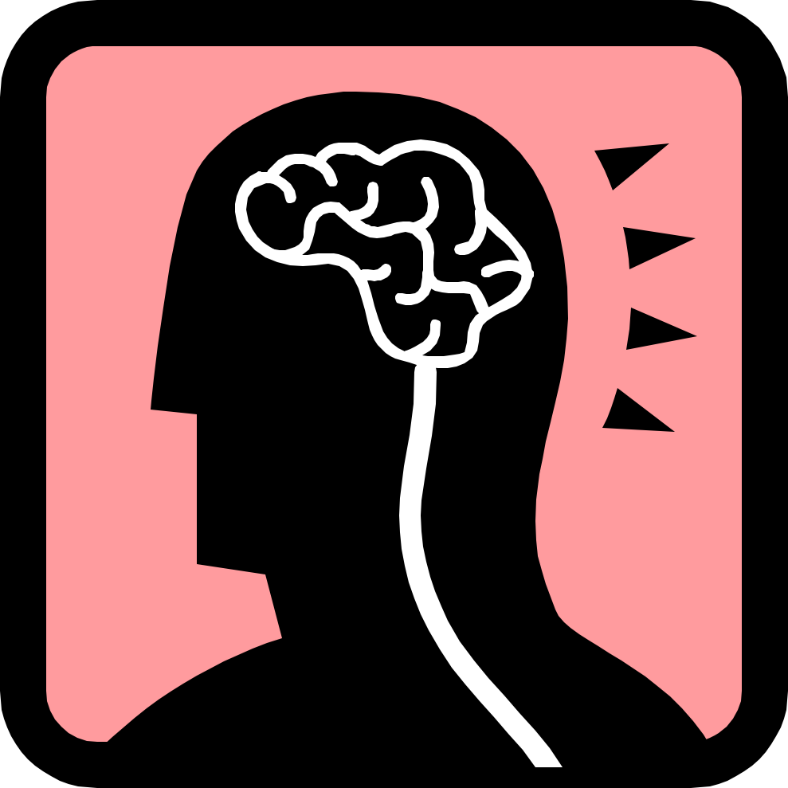
Whole Grains
Energetically balanced
Are both a seed and fruit
  Contain the whole life span
  Energy helps us develop whole way of thinking
Have complex carbohydrates
  Energy for brain
  Develop clear thinking
  Good instinct
  Stable emotions
Clean fuel that doesn’t clog the body
22

Slide 23

Are you with me?
23
Notes:
Are you with me?
Any questions?
Any observations? Comments?
-----------------------
Let’s move ahead.
----------------------
Turn to question # 4 in your workbook
What norms do I use to define my status and happiness?

Slide 24
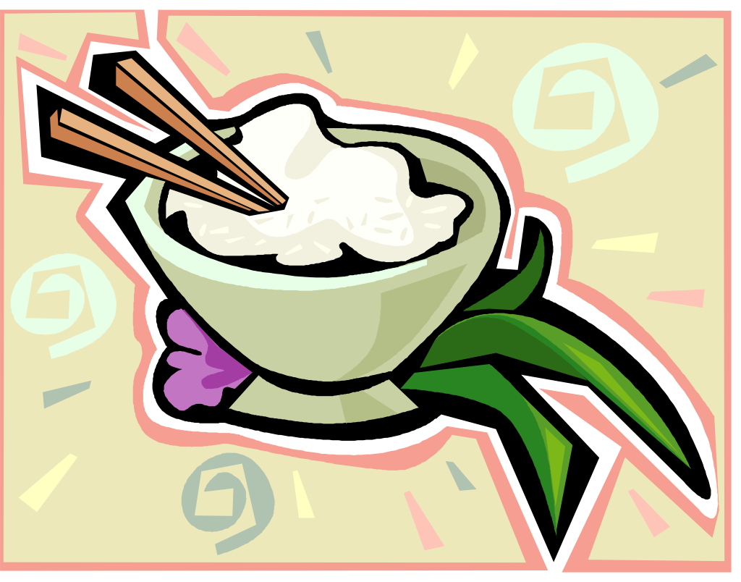
Eating macrobiotic foods helps us develop our intuition.
24

Slide 25
What is intuition?
The power or faculty of attaining to direct knowledge or cognition without rational thought or inference. (Webster’s Dictionary)
Direct perception of truth, fact, etc., independent of any reasoning process; immediate apprehension (Dictionary.com)
25

Slide 26

Developing Intuition
We eat human food, we become charged as humans
  Body becomes balanced with earth
  Living in harmony with nature
  Body becomes healthy
If stagnation, energy between heaven and earth doesn’t flow
When our body channel is as clear as possible
  Our bodies become charged
  Open to receiving universal energy
26

Slide 27

Ways to Strengthen Intuitive Channel
Whole Foods
Chewing
Less Eating
Mineral rich foods
  Develop nervous system, center of antennae
  Greens, roots, sea salt, sea veg., seasonings (soy sauce, miso)
  Iron in blood acts as antenna for infinity
  If overeat them, become too rigid in way of thinking
Lifestyle—Daily contact with nature
Physical Activity—Discharge excess wastes
27

Slide 28
Eating Macrobiotic Food
Seasonal Food
Cooking According to Seasons
Whole Foods
In touch with seasons
Connects you with nature
Contribute to whole person (whole foods for whole people)
28

Slide 29
Macrobiotic Diet
Whole grains and vegetables
Spring
Slightly cooling energy foods
  Barley, oats, wheat, rye
  Sprouts, celery, scallions
  Lightly cooked dishes
Summer
Cooling energy foods
  Maize/Corn
  Summer vegetables
    Leafy greens
    Summer squash
  Lightly cooked, cooling dishes (salads)
29

Slide 30
Macrobiotic Diet
Whole grains and vegetables
Late Summer
Slightly warming energy foods
  Millet
  Round vegetables
    Cabbage
    Turnip
  Longer cooked dishes
Autumn
Warming energy foods
  Brown rice
  Root vegetables
    Carrot
    Burdock
  Longer cooked, warming dishes
30

Slide 31
Macrobiotic Diet
Whole grains and vegetables
Winter
Warming energy foods
  Buckwheat
  Root vegetables
  Longer cooked, warming dishes
31

Slide 32
Change your destiny
Stream of destiny based on choices and interactions
Certain choices cause certain destiny
  Choices not chances
  Experience is based on stories we choose to believe
Choosing ability depends on highest level of intuition
If intuition is dulled
  Divorced from environment (yin sanpaku)
  Intuitive sense (gut feeling) can’t pick up subtle energies to avoid danger
  Can’t make healthy choices
32

Slide 33

When you eat energetically balanced foods, you can deepen your connection with nature and spirit.
33

Slide 34


Macrobiotic Food
Vibrates at higher frequency than extreme foods
Energetically balanced
To feel and receive energies from environment
Pick up subtle thoughts and ideas from your intuition
Develop a stronger connection with spirit
34
Notes:
Not only that, macrobiotic food vibrates at higher frequencies than extreme foods that are not energetically balanced.

Slide 35

An Inspiring Life
Macrobiotics helps create balance in whole body
Harmonizing emotions, mind, body, spirit
Develop your intuition and spirituality
Living a life filled with
  Health
  Happiness
  Freedom
Based on choices
35
Notes:
Through macrobiotics, we can understand how to create balance in all areas of the body, as we harmonize the emotions, mind, and spirit as well. Therefore, by developing our intuition and spirituality, we can live a life filled with health, happiness, and freedom, based on the choices we make.

Slide 36

We are not human beings on a spiritual journey.
We are spiritual beings on a human journey.
- Stephen Covey
36

Slide 37
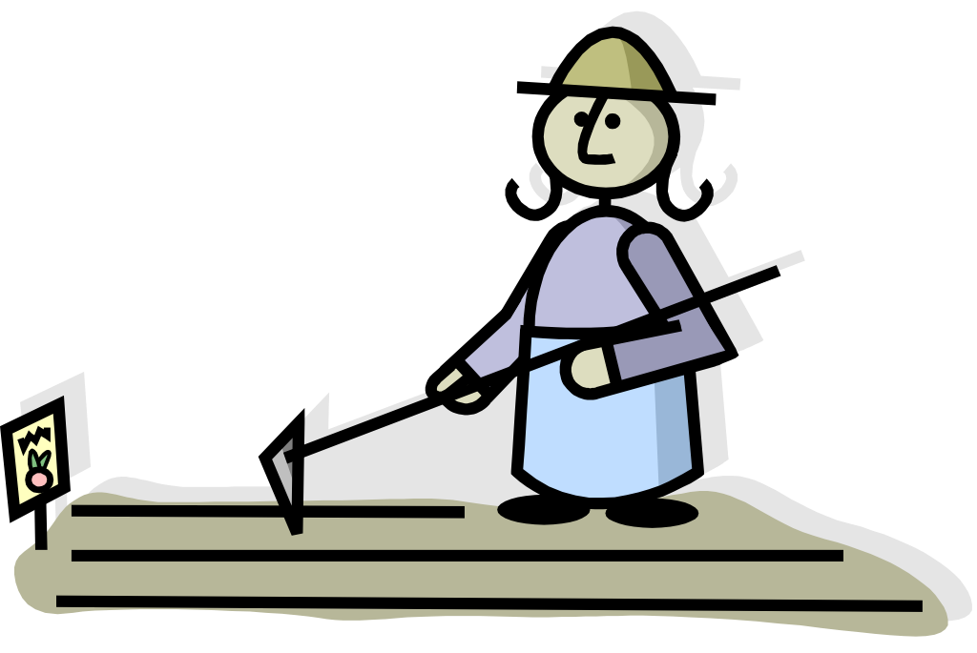
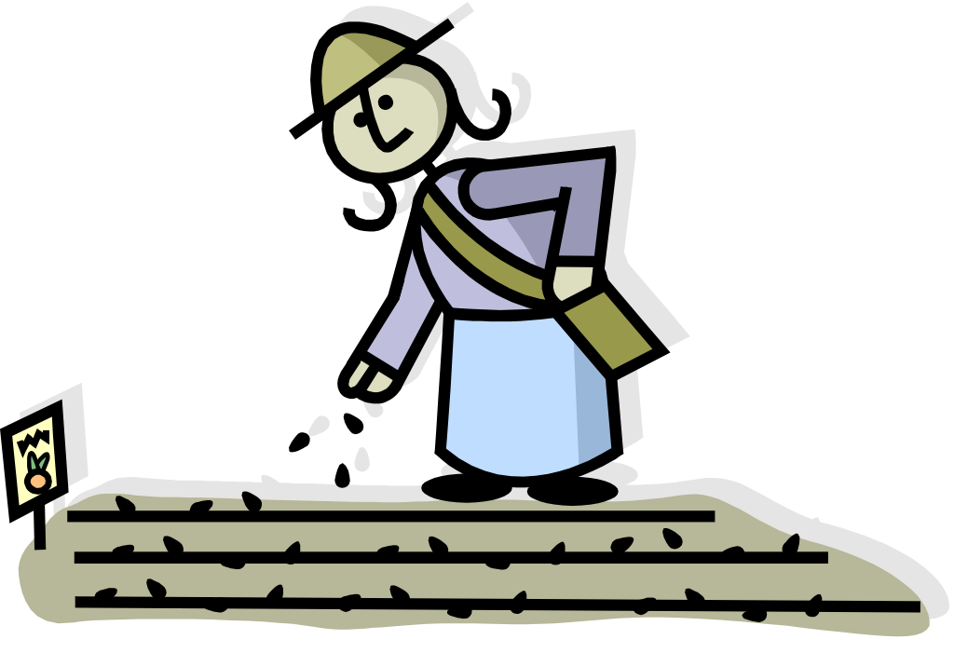
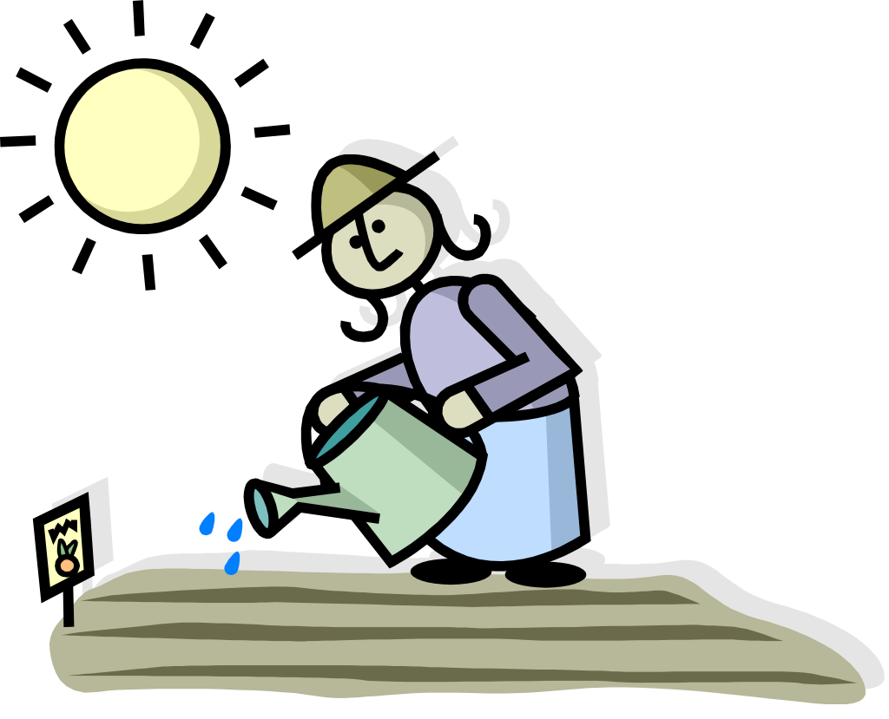
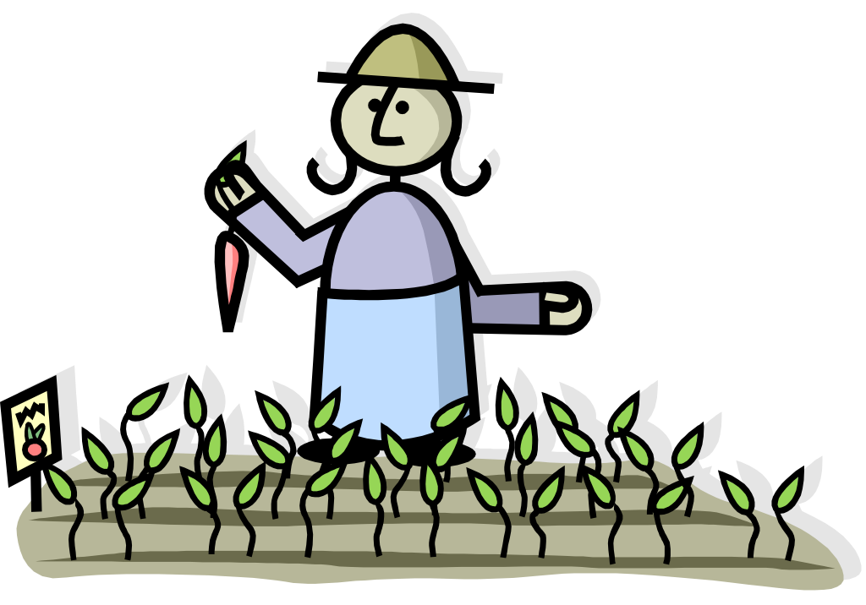
Planting the seeds of
health and well-being
37
Notes:
PLANTERS, SOIL, SEEDS
(Symbolic planting of the seeds of growth)
You have now planted a seed of inspiration to open yourself up to intuition and inner guidance.
Like all seeds, it will need care. If the seed is ignored, no plant will grow. Once it begins to grow, it will require nurturing to see the results. It will eventually become a plant and it will bear whatever fruit your plant bear.
Your spiritual path is the same. By setting the intention and nurturing your intuition and listening to your inner guidance, you can cultivate a rich abundant life. The more attentive you are to making it a norm for yourself, the more fruit it will bear in your life.

Slide 38

A life that I love!
38
Notes:
You are now on a new path of health and well-being, bearing the fruit of your happiness and fulfillment, living a life that you love. Congratulations!

Slide 39










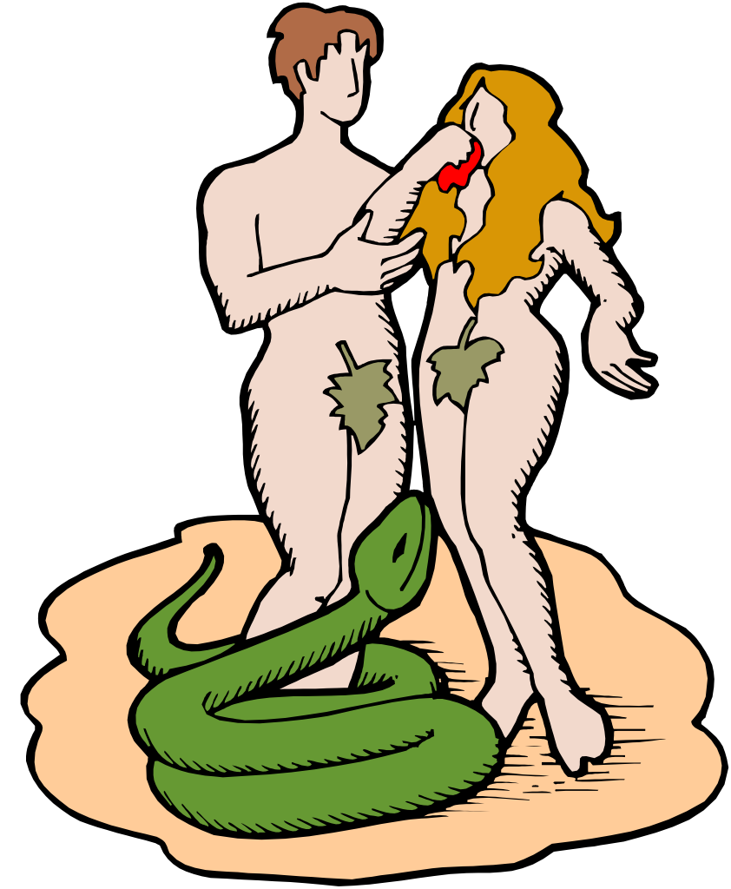
CONGRATULATIONS!
39

Slide 40
Thank you
40

